Slide 1

Social Media Analysis
E X P E R I M E N T N O . 0 5

Slide 2



STEP 1
Open the Chrome Web Store and search for "Instant Data Scraper".
Click on the extension, then click "Add to Chrome" and follow the prompts to install it.
Add “Instant Data Scrapper” to your
Google Chrome.

Slide 3

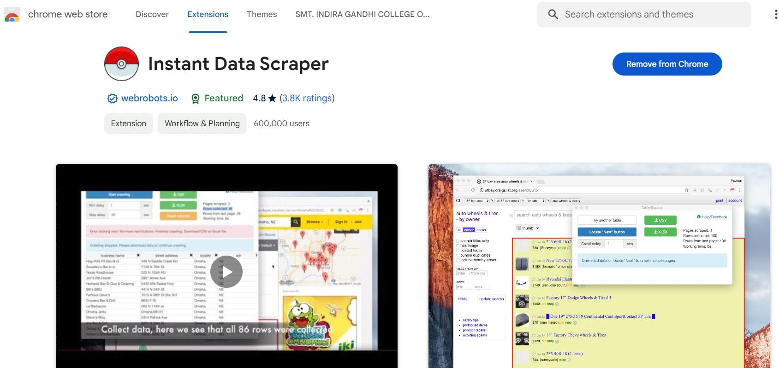

Extension

Slide 4
STEP 2
Go to the Google Maps and look for the Local Business that interest you.
After searching completes, open reviews option for further process.

Slide 5

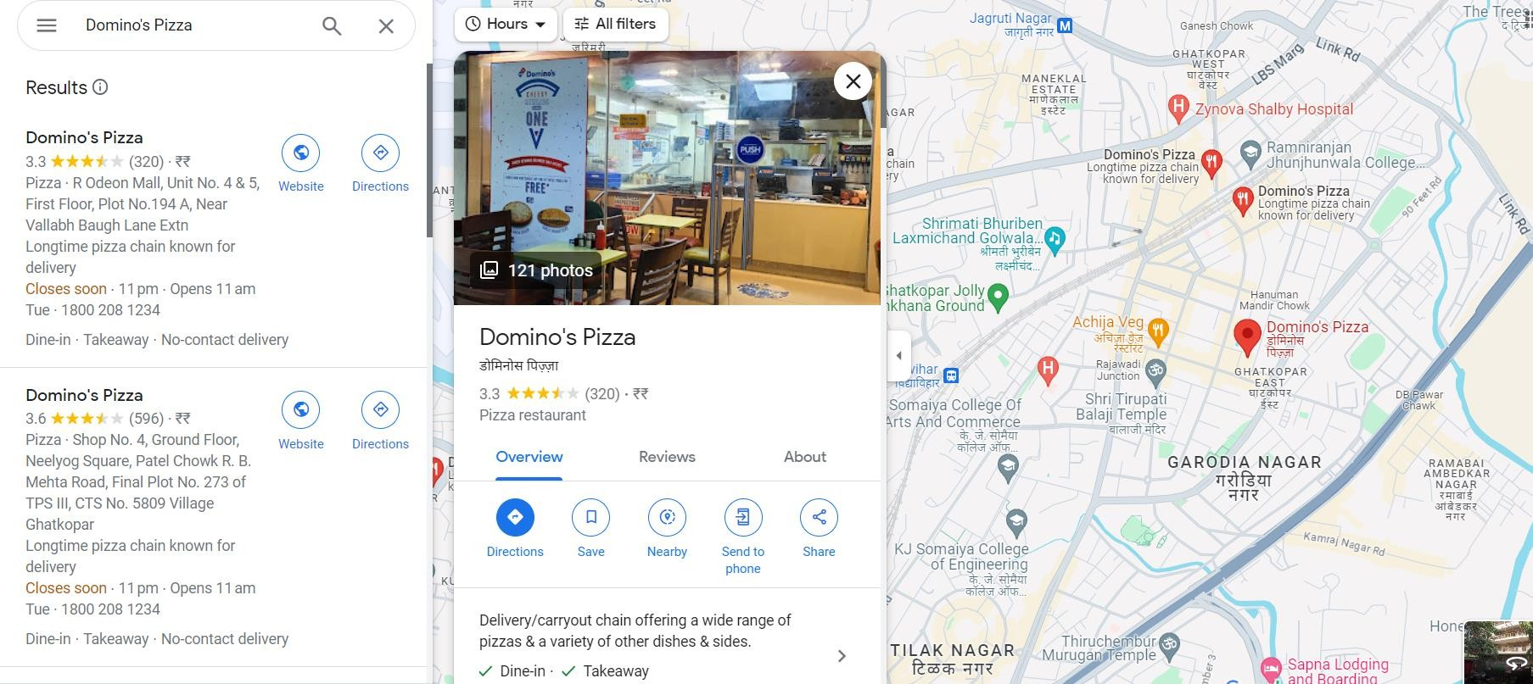

SEARCH RESULT

Slide 6

STEP 3
Open the webpage containing the Google reviews you want to scrape.
On the Instant Data Scraper extension icon in your Chrome browser, select the data you want to scrape (in this case, the reviews), and launch the scraper. Then, wait until all reviews have been scraped.

Slide 7

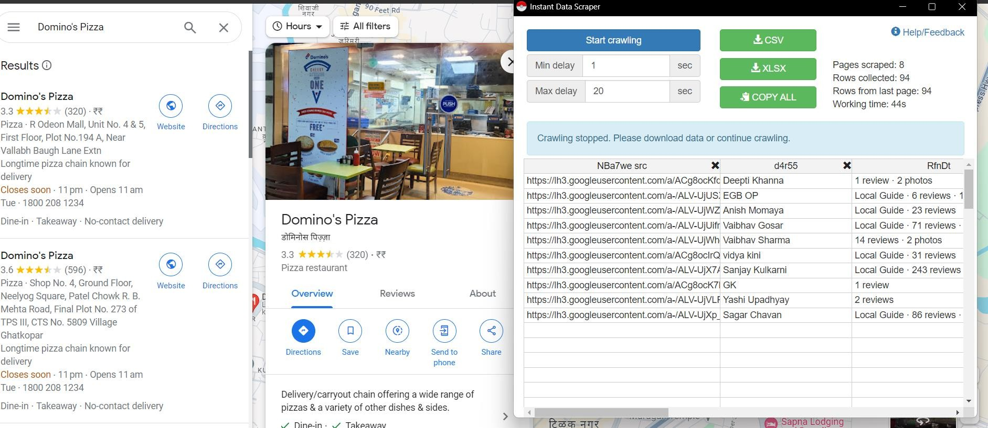

WEBPAGE

Slide 8

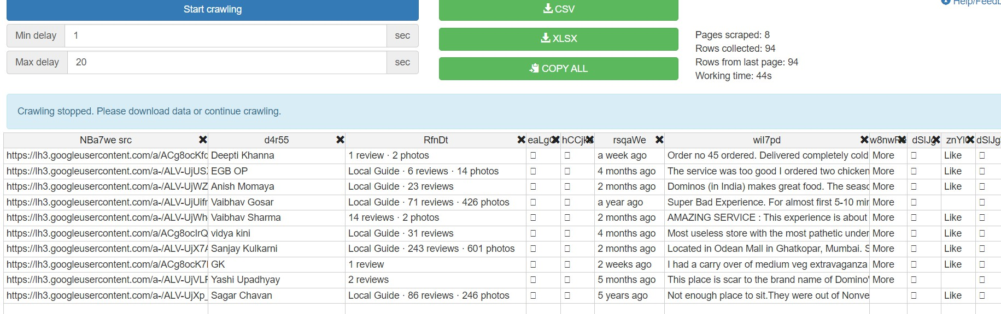
Reviews After Scrapping

Slide 9
STEP 4
Select min delay and Max delay as per your requirement.
Then start Crawling.

Slide 10

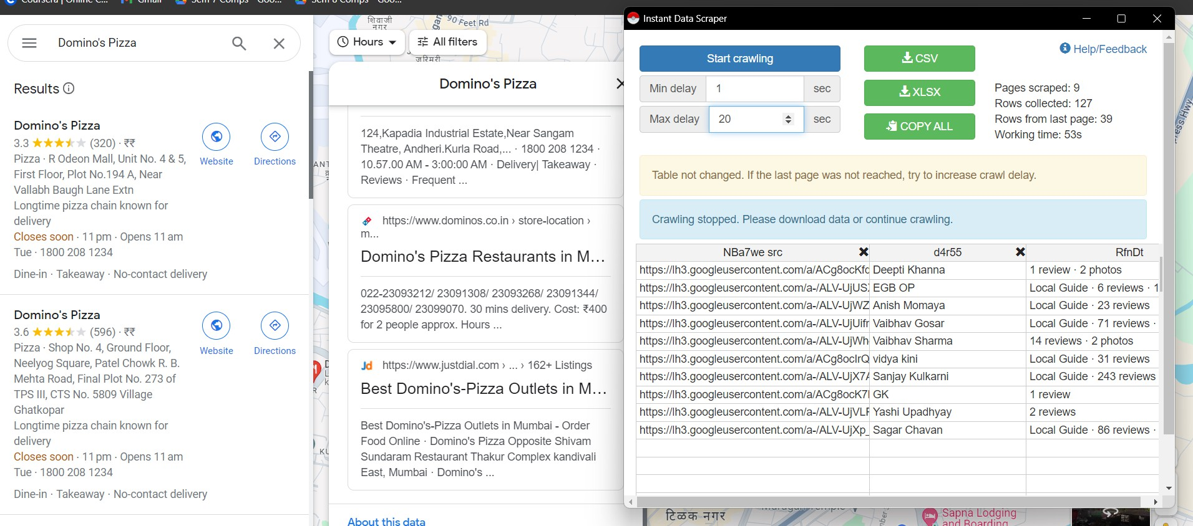

Slide 11

TOPIC MODELING
Topic modeling is a machine learning technique that automatically analyzes text data to determine cluster words for a set of documents. This is known as 'unsupervised' machine learning because it doesn't require a predefined list of tags or training data that's been previously classified by humans.
Topic Modelling in Social Media Analytics help with understanding what people are talking about in pertaining to the particular place, thing, etc.

Slide 12
Topic modeling, such as with Latent Dirichlet Allocation (LDA) in Python
It is a technique used to uncover hidden thematic patterns within a collection of documents. It operates like clustering for text data, identifying inherent groups or themes (topics) without predefined labels or categories.

Slide 13
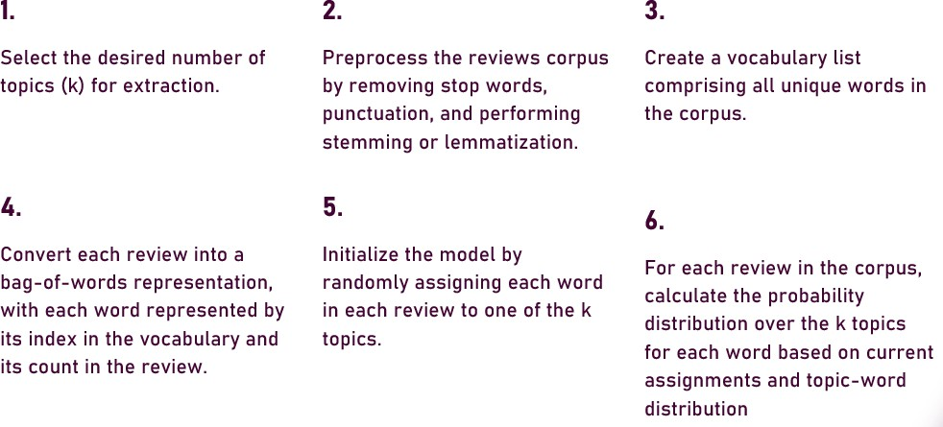
Steps in LDA

Slide 14
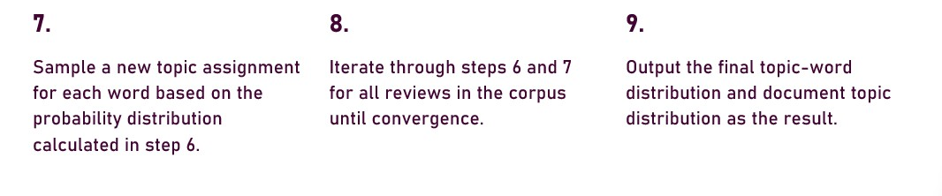
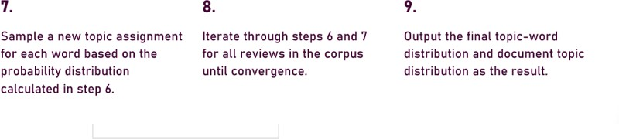

Slide 15
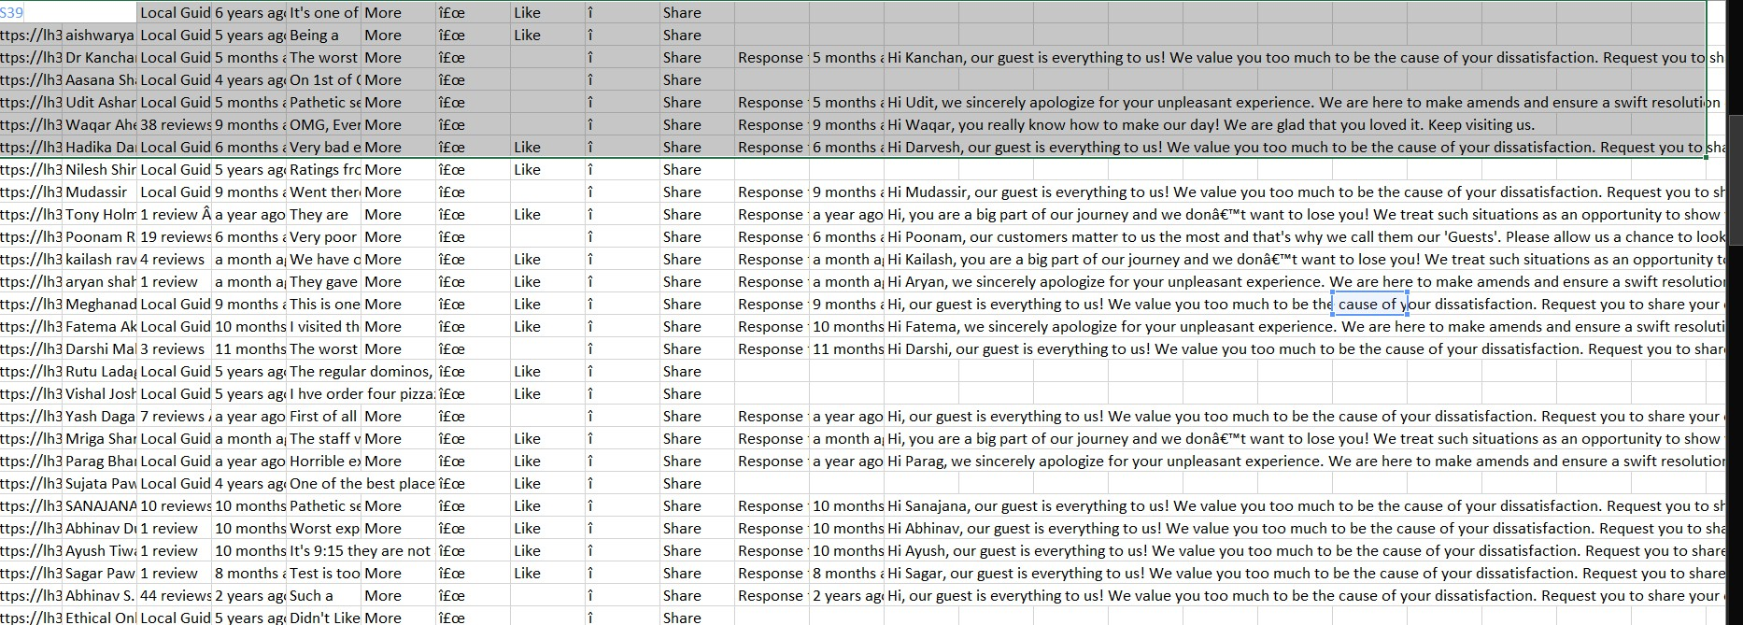
REVIEW DATASET

Slide 16

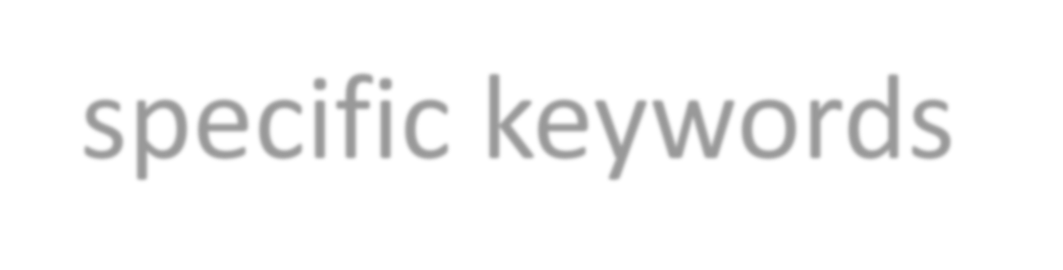
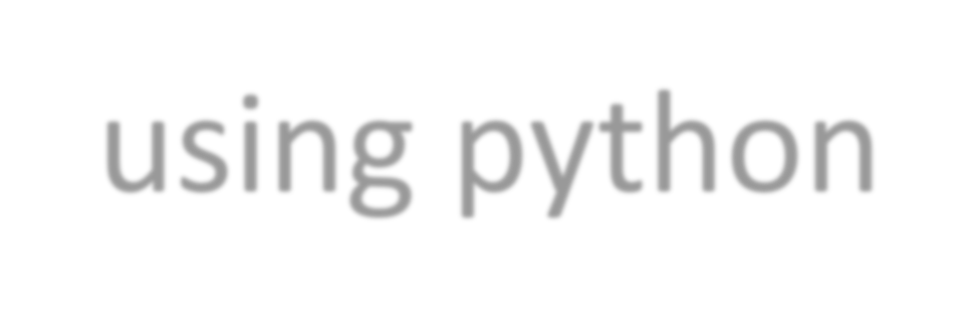
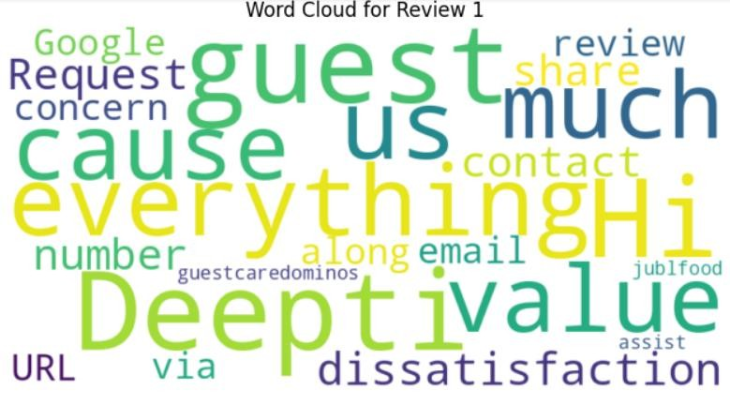
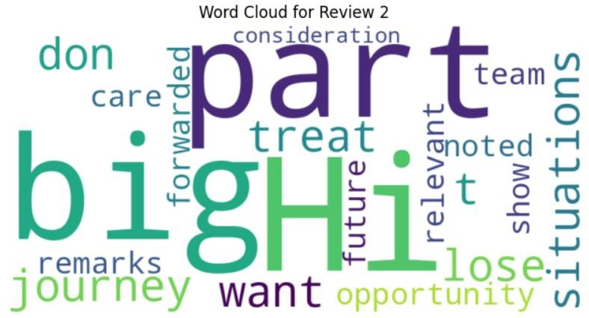
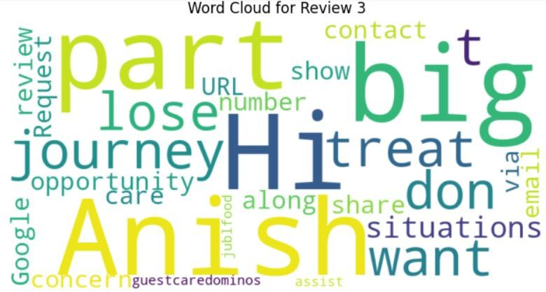
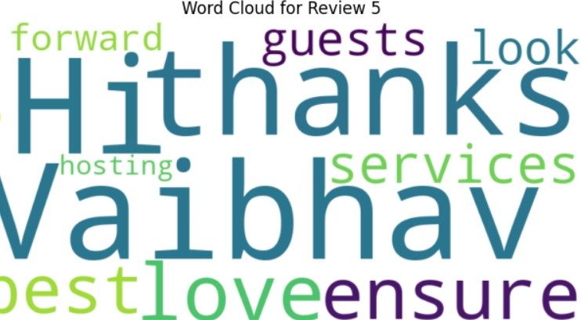
Visualization of review-specific keywords using python

Slide 17






T-SNE Clustering of all Reviews

Slide 18
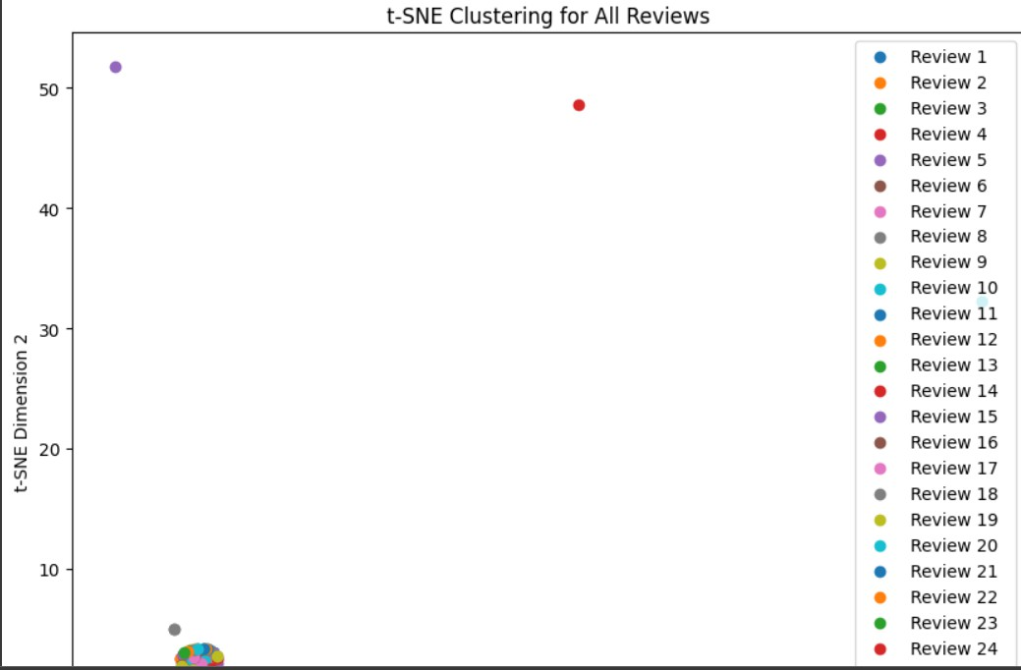

Slide 19

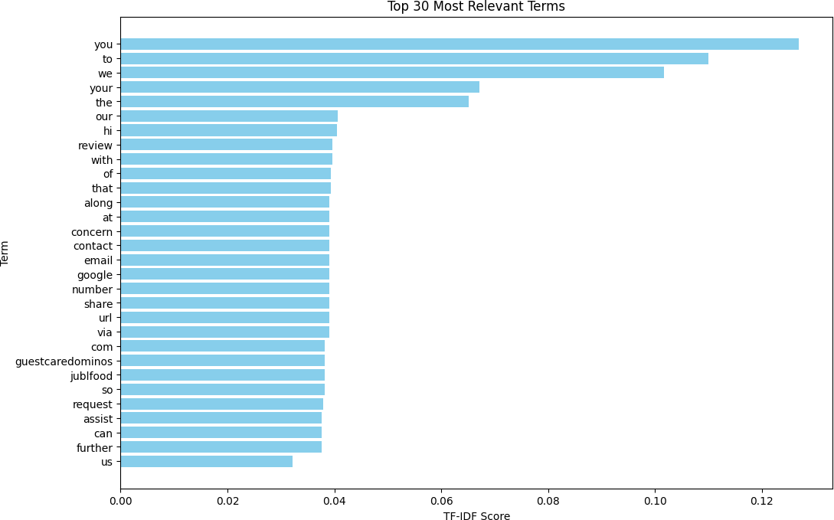
STUDIO SHODWE

Slide 20





Thank You

